Slide 1

Email & letter
Session VI: Groups & Teams (In) Action

Slide 2
Chapter outlines
Email
Memorandums and Letters

Slide 3
LEARNING OBJECTIVES
By the end of this section, you will be able to:
Discuss the role of text messaging in business communication.
Write effective e-mails for both internal and external communication.
Discuss the purpose and format of a memo.
Understand effective strategies for business memos.
Describe the fifteen parts of a standard business letter.
Access sample business letters and write a sample business letter.

Slide 4
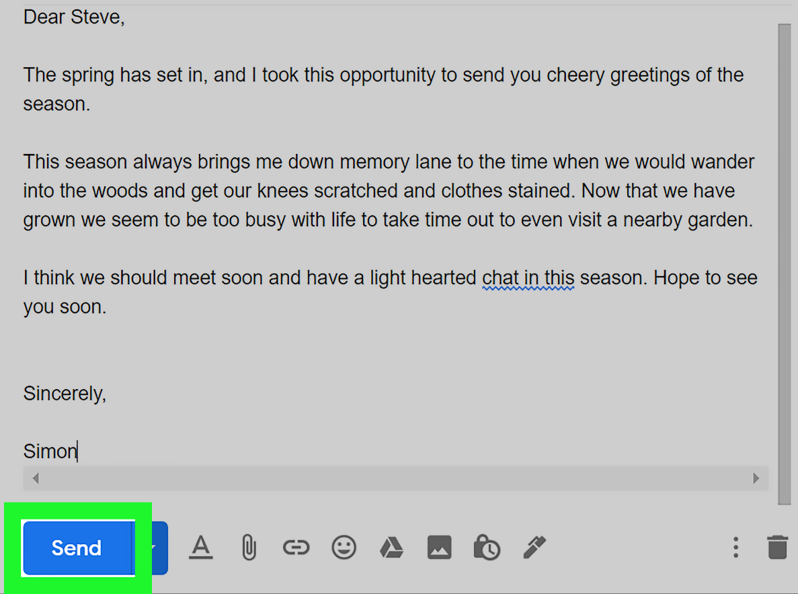
1. What is email
Electronic mail, usually called e-mail
It may be used like text, or synchronous chat, and it can be delivered to a cell phone.

Slide 5
Tips for Effective Business E-mails

Slide 6
1. Proper salutations should demonstrate respect and avoid mix-ups in case a message is accidentally sent to the wrong recipient.
For example, use a salutation like “Dear Ms. X” (external) or “Hi Barry”
(internal).

Slide 7
2. Subject lines should be clear, brief, and specific. This helps the recipient understand the essence of the message.
For example, “Proposal attached” or “Your question of 10/25.”

Slide 8
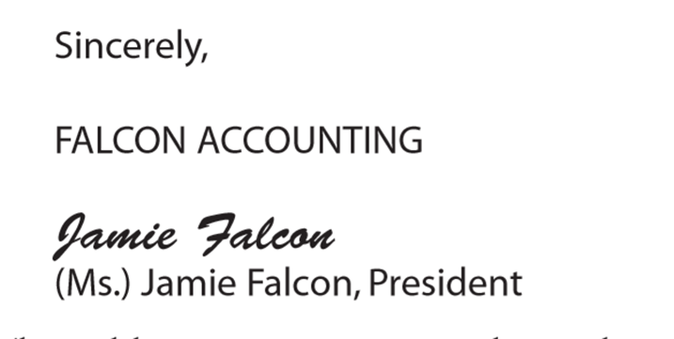
3. Close with a signature. Identify yourself by creating a signature block that automatically contains your name and business contact information.

Slide 9

4. Avoid abbreviations. An e-mail is not a text message, and the audience may not find your wit cause to ROTFLOL (roll on the floor laughing out loud).
5. Be brief. Omit unnecessary words.

Slide 10
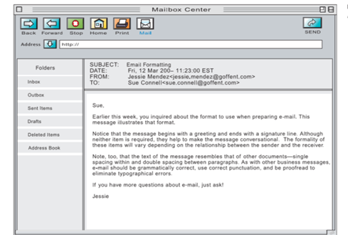
6. Use a good format
Include line breaks between sentences or divide your message into brief paragraphs for ease of reading.
A good e-mail should get to the point and conclude in three small paragraphs or less

Slide 11
7. Reread, revise, and review.
8. Reply promptly
9. Use “Reply All” sparingly
10. Avoid using all caps.
11. Test links. If you include a link, test it to make sure it is complete.
12. E-mail ahead of time if you are going to attach large files (audio and visual files are often quite large) to prevent exceeding the recipient’s mailbox limit or triggering the spam filter.
13. Give feedback or follow up.

Slide 12
Activity
Find an example of an e-mail that you wish you had never sent or received. Rewrite it to eliminate the characteristics that you find problematic.
Share it with your classmates.

Slide 13
2. Memorandums and Letters
Memos: (or memorandum, meaning “reminder”) is normally used for communicating policies, procedures, or related official business within an organization.
Letters are brief messages sent to recipients that are often outside the organization.

Slide 14
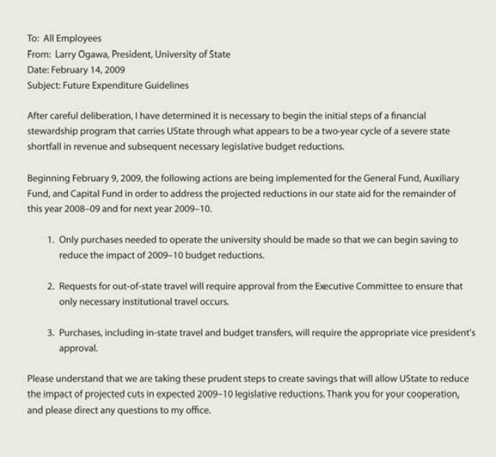
2.1 Memo Format
Use
To:
From:
Date:
Subject:
Writer signs or writes initials near keyed name in the heading

Slide 15
Five Tips for Effective Business Memos
Audience Orientation
Professional, Formal Tone
Subject Emphasis
Direct Format
Objectivity

Slide 16
2.2 Elements of a Business Letter
1. Return Address
2. Date
3. Reference (Re:)
4. Delivery (Optional)
5. Recipient Note (Optional)
6. Salutation
7. Introduction
8. Body
9. Conclusion
10. Close
11. Signature
12. Preparation Line
13. Enclosures/ Attachments
14. Courtesy Copies or “CC”
15. Logo/ Contact Information

Slide 17
Strategies for Effective Letters
Remember that a letter has five main areas:
1. The heading, which establishes the sender, often including address and date
2. The introduction, which establishes the purpose
3. The body, which articulates the message
4. The conclusion, which restates the main point and may include a call to action
5. The signature line, which sometimes includes the contact information

Slide 18
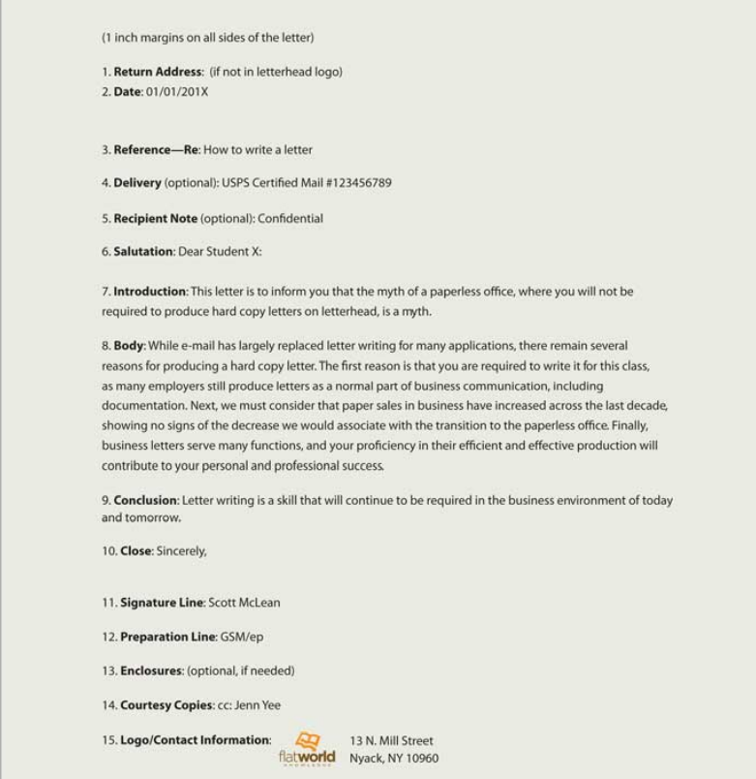
Sample Business Letter

Slide 19
To communicate effectively and project a positive image
• be clear, concise, specific, and respectful;
• each word should contribute to your purpose;
• each paragraph should focus on one idea;
• the parts of the letter should form a complete message;
• the letter should be free of errors.

Slide 20
Activity
Create a draft letter introducing a product or service to a new client.
Post and share with classmates.

Slide 21
Key Takeaway
E-mail is useful for both internal and external business communications. The content and formatting of an e-mail message should reflect professionalism and follow the rules of netiquette.
Memos are brief business documents usually used internally to inform or persuade employees concerning business decisions on policy, procedure, or actions.
Letters are brief, print messages often used externally to inform or persuade customers, vendors, or the public.
A letter has fifteen parts, each fulfilling a specific function

Slide 22
Exercises
Choose at least three e-mails you have sent or received that are good examples of business communication. What makes them good examples? Could they be improved in any way? Share your suggestions with classmates.
Find a memo from your work or business, or borrow one from someone you know. Share it with your classmates, observing confidentiality by blocking out identifying details such as the name of the sender, recipient, and company. Compare and contrast.
Create a draft letter introducing a product or service to a new client. Post and share with classmates.
Write a memo informing your class that an upcoming holiday will be observed. Post and share with classmates.
Find a business letter (for example, an offer you received from a credit card company or a solicitation for a donation) and share it with your classmates. Look for common elements and points of difference.

Slide 23


